Slide 1
Working with Azure Database Services Platform
Roberto Freato

Slide 2
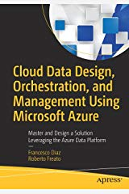
Chapter 1
Cloud Data Design, Orchestration and Management Using Microsoft Azure

Slide 3
Platform-as-a-Service
PROS:
No VMs to maintain
No separate licence to manage
No need to implement HA/HR
CONS:
«Limited» size (up to 4TB or 100TB on Hyperscale)
«Limited» performance levels (from 0 to 80 cores)
No low-level tuning (missing interface with the underlying OS)
Costs

Slide 4
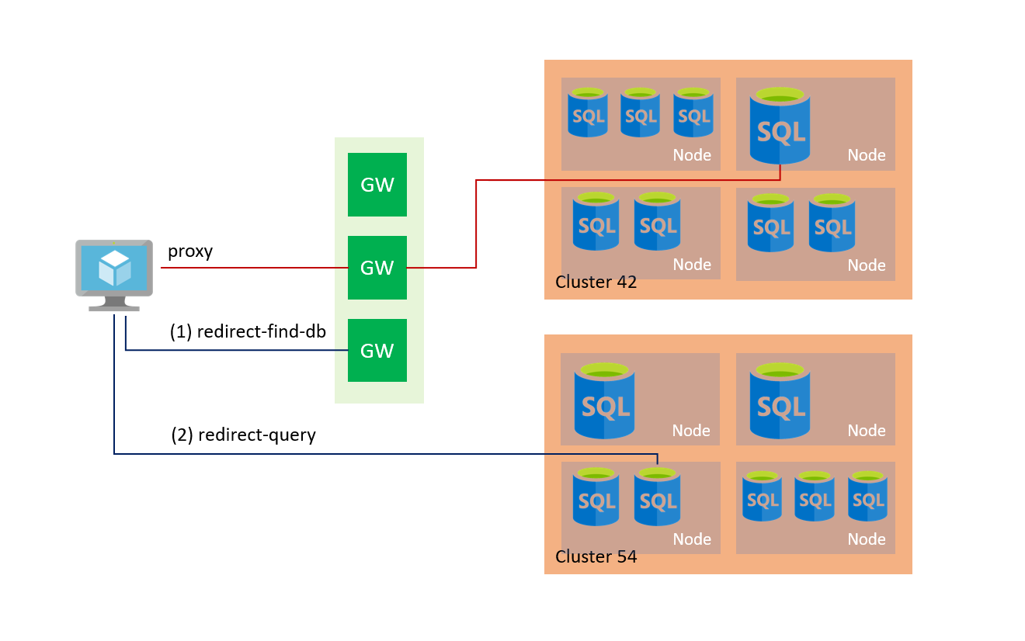
Connectivity
Public endpoint
Virtual Network (and/or specific endpoints)
PROXY MODEL

Slide 5
Tiers and models
Single database:
DTU-based
vCore-based
Serverless
Multiple databases:
Elastic Pools (DTU or vCore based)
Managed Instances

Slide 6
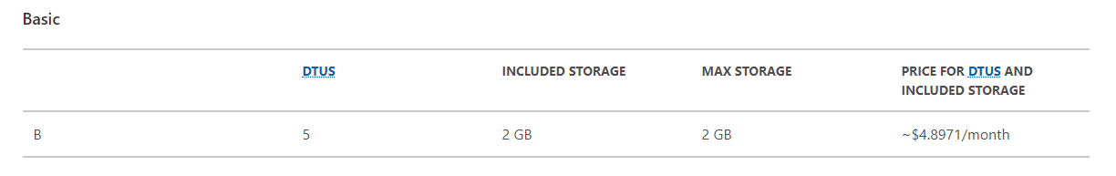
Single: DTU-based (Basic)

Slide 7
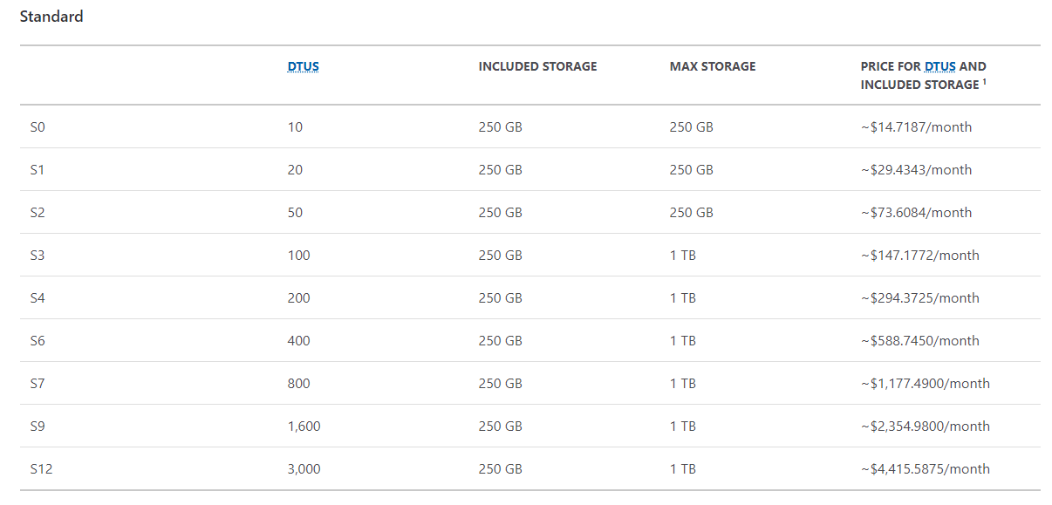
Single: DTU-based (Standard)

Slide 8
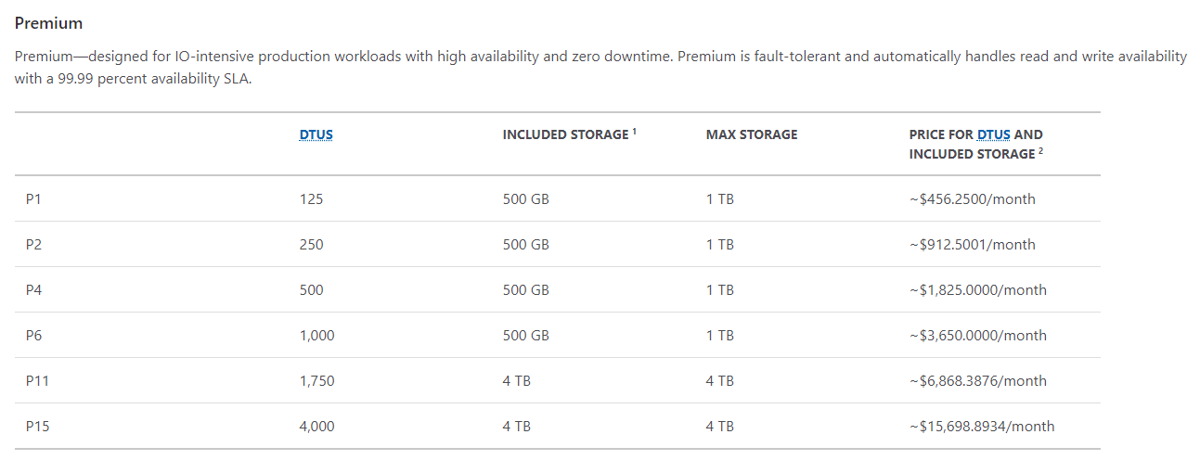
Single: DTU-based (Premium)

Slide 9
Single: vCore-based
General purpose: some caps in performance
Business critical: much performance
Hyperscale: different architecture (up to 100TB)
PLUS
Hybrid Benefit
Serverless

Slide 10
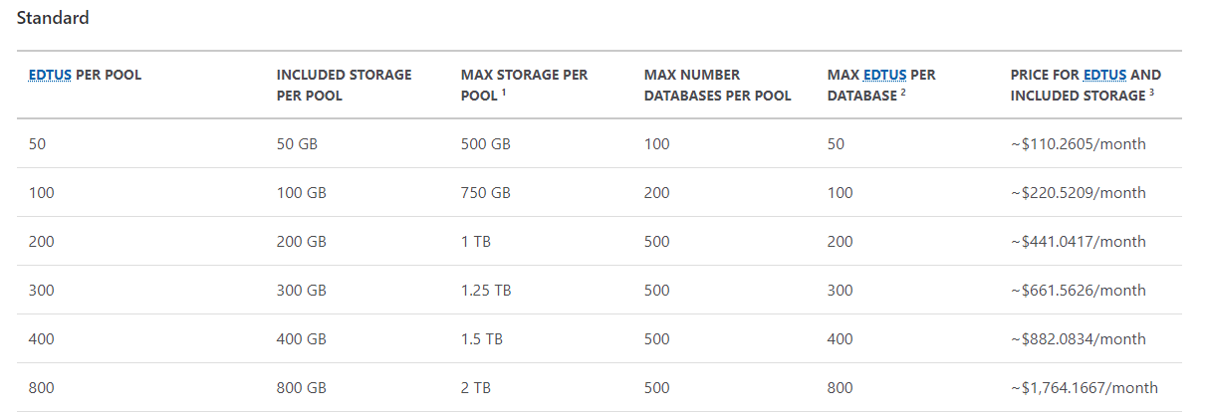
Multiple: elastic pools
vCore model has same price point

Slide 11
DEMO
Tiers

Slide 12
Security Basics
Server-level:
Virtual Network
Encryption (TDE + TLS)
Both Server-level and Database-level
Firewall
Authentication
Always Encrypted
Dynamic Data Masking

Slide 13
DEMO
Firewall, Authentication, Always Encrypted, Data Masking

Slide 14
Automatic tuning

Slide 15
Read replica
Always available in:
DTU-based Premium Tier
vCore-based Business Critical
vCore-based Hyperscale
ApplicationIntent = ReadOnly

Slide 16
DEMO
Read replicas

Slide 17
Geo-replication

Slide 18
Failover groups
Define a primary DNS endpoint
Bound the (current) primary DB to the endpoint
To the same with a secondary endpoint
Transparent usage of the primary endpoint from applications

Slide 19
DEMO
Geo-replication and Failover groups

Slide 20
Backups
Point-In-Time restore (up to 35 days)
Long-term backups
Copies

Slide 21
DEMO
Backups and copies

Slide 22
Security basics (2)
Query Performance Insight
Database Auditing
Advanced Data Security

Slide 23
DEMO
Query store & Auditing

Slide 24
Takeaways
Reduced effort in governance
Many deployment and consolidation options
Several pricing tiers
Many of the SQL Server features (preview ones!)
Intelligent features (like auto-tuning)
Designed for HA/HR (geo-replication, failover groups)
No backup hassle

Slide 25
Working with Azure Database Services Platform
Roberto Freato

Slide 26



Please rate this session using
Event Master
Mobile App
User Panel (registration.join-conference.com)
Session rating booth

